Slide 1
IBM Literature Survey
Signs With Smart Connectivity For Better Road Safety
DOMAIN: Internet of things
By
Anusuya SLK
Hemananthini R
Meghaa N
Pragathii AU

Slide 2
Smart Traffic Sign Boards (STSB) for Smart Cities
Link: https://ieeexplore.ieee.org/stamp/stamp.jsp?tp=&arnumber=9124950
Introduction:
At the same time, the infrastructure needs to be created to cater to the requirements of autonomous vehicles. For enabling smart transportation, the infrastructure may include roadside infrastructure, adaptive traffic signals, electronic toll collection etc. Some of the major applications of the V2I communication may be
-Smart traffic sign boards -Over speed warning -Curve warning -Toll Collection -Overload / oversize vehicle warning -Weather information

Slide 3
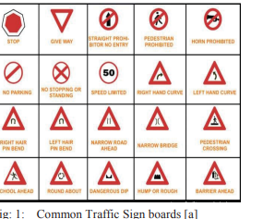
Proposed Framework
Proposed system converts the normal sign boards to
smart signboards which will send the data to the
installed system placed inside the vehicle and
generate a user friendly voice alert to prevent the
travellers from unexpected, hazardous or unusual
feature of the road, which may be missed by the
driver due to various reasons like night, fog, rain,
may leads to tragic accidents, smash, or life threatening situations. To avoid that, our proposed framework of the system will be communicating with the traffic signs automatically and it will give an advance alert to slow down the speed and related information on the screen, it also translates that information to a user friendly voice message.

Slide 4
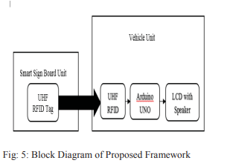
Algorithm
Step 0: Start
Step 1: UHF RFID reader which is placed on the car/vehicle will read the RFID tag placed on traffic sign boards.
Step 2: The connected Arduino board will read the code from the RFID reader and will decrypt that code of RFID into a user friendly message describing the meaning of the Sign.
Step 3: The message will be displayed on the connected screen which is placed near the driver in the vehicle.
Step 4: The text message will be converted into a user friendly voice message in parallel.
Step 5: Stop

Slide 5
IoT based smart traffic signal monitoring system using vehicles counts
Link: https://www.researchgate.net/publication/325116849_IoT_based_smart_traffic_signal_monitoring_system_using_vehicles_counts
INTRODUCTION
Traffic signal management is one of the major problematic issues in the current situation.
Such scenarios, every signal are getting 60 seconds of timing on the road at a regular interval, even when traffic on that particular road is dense.
As per this proposed model in this article, which will be optimized the timing interval of the traffic signal purely depends on the number of vehicles on that particular roadside
ADVANTAGE:
The major advantage of this system is that it can able to decrease the more waiting time for the drivers to cross road signal.
ALGORITHM:
In this model, we are using the clustering algorithms model which is based on KNN algorithm.
Using this algorithm new model will be liable to determine expected required timing as per provided inputs to the signal which is vehicles count.
The input of these systems is vehicles counts on each side of the road from crossing signal. And this input will be determined on much time is to be provided.

Slide 6
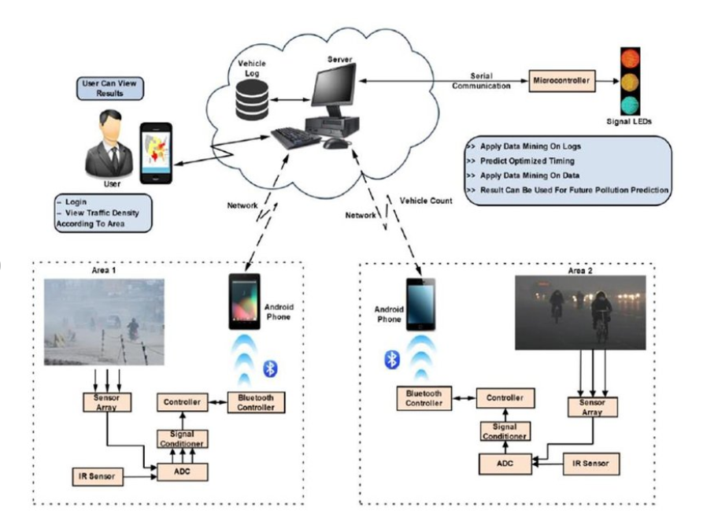

Slide 7
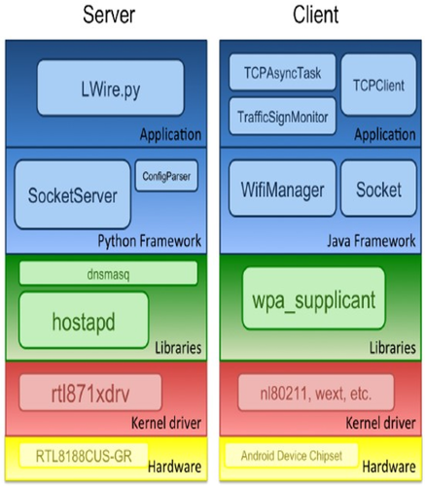
Wireless digital traffic signs of the future - https://ietresearch.onlinelibrary.wiley.com/doi/full/10.1049/iet-net.2018.5127
Digital traffic sign posts will be capable of transmitting the traffic sign information wirelessly to road users, and this will transform our roads into intelligent roads, where signs will appear promptly and automatically on in-vehicle displays to alert the driver.
Future scope:
Spectrum
Power
Weather
Security
Regulations on hardware
Future traffic violation detection

Slide 8
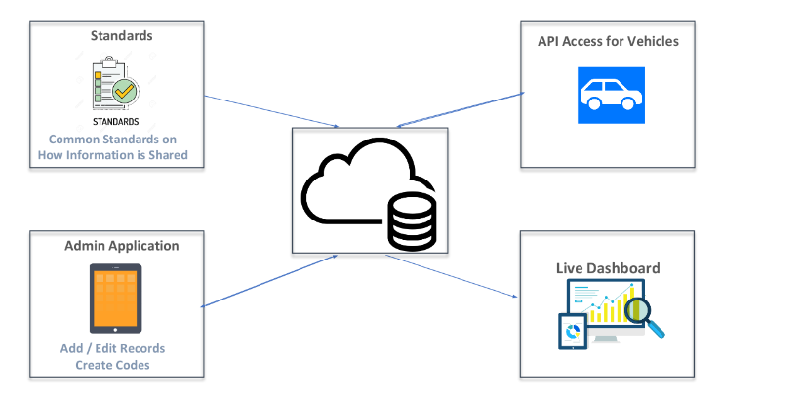
Smart Self Enforcing Road Signs- https://eventornado.com/submission/smart-self-enforcing-road-signs?s=1#ideas
The digital road sign warrants can be changed and updated dynamically.(i.e) enforce speed limit restrictions.
Future scope:
In Future Infrastructure should have the ability to exchange data with Self-Driving system

Slide 9
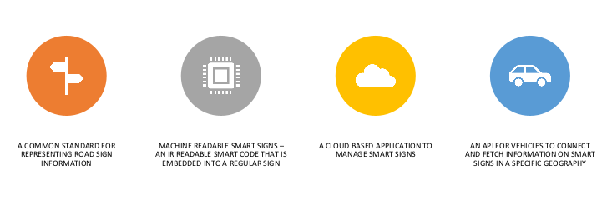
The Idea

